Slide 2
Our Experience Hiring Data Scientists
I’ve been in charge of recruiting for the past 2 years, so I have been in contact with most/all of our candidates in the process.
500 | Applications considered
250 | First phone screens
120 | Second phone screens
60 | Onsite interviews
20 | Offers for employment given

Slide 3
The Data Science Venn Diagram
Understanding the Data Science Venn Diagram can help faculty better prepare their students for careers in data science.
Computer Science
Skills
Mathematics/
Statistics
Knowledge
Machine
Learning
Scientist
Data
Scientist
Danger
Zone!
Traditional
Research
Substantive Expertise
Domain Knowledge
Thanks to Drew Conway

Slide 4
The Data Science Venn Diagram
As an educator you have the ability to primarily influence these components.
Also note that they are equally-sized. This is important, and correct.
Computer Science
Skills
Mathematics/
Statistics
Knowledge
Machine
Learning
Scientist
Data
Scientist
Danger
Zone!
Traditional
Research
Substantive Expertise
Domain Knowledge
Thanks to Drew Conway

Slide 5
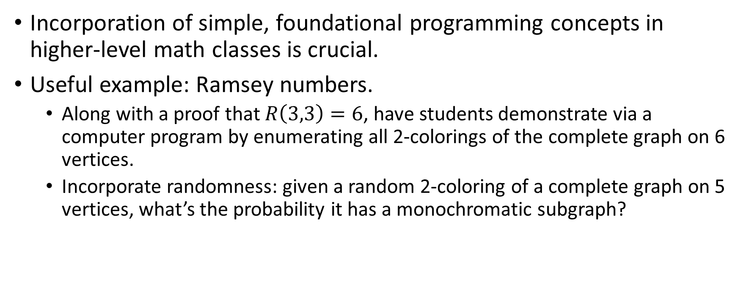
Effective Computer Science for Mathematicians
Incorporation of simple, foundational programming concepts in higher-level math classes is crucial.
Useful example: Ramsey numbers.
Along with a proof that $R\left(3,3\right)=6$, have students demonstrate via a computer program by enumerating all 2-colorings of the complete graph on 6 vertices.
Incorporate randomness: given a random 2-coloring of a complete graph on 5 vertices, what’s the probability it has a monochromatic subgraph?

Slide 6
The Data Science Venn Diagram
Also, note what’s not available when you are lacking mathematics and statistics knowledge. This is important. When a student is choosing between a computer science major and a mathematics major, then that student should choose mathematics.
Computer Science
Skills
Mathematics/
Statistics
Knowledge
Machine
Learning
Scientist
Data
Scientist
Danger
Zone!
Traditional
Research
Substantive Expertise
Domain Knowledge
Thanks to Drew Conway

Slide 7
The Data Science Venn Diagram
Understanding the Data Science Venn Diagram can help faculty better prepare their students for careers in data science.
Computer Science
Skills
Mathematics/
Statistics
Knowledge
Machine
Learning
Scientist
Data
Scientist
Danger
Zone!
Traditional
Research
Substantive Expertise
Domain Knowledge
Thanks to Drew Conway

